Slide 1
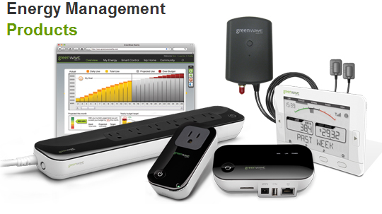
EMS Team Meeting
Johnny Nguyen
Camilo Aguilar
Upa Sundaram
Charles Lam
June 3, 2013

Slide 2
Problem: Recognizing Similar types of Devices
Waveforms of laptops in steady state similar:
Becomes even more complicated with different power consumption modes, whether or not the laptop is fully charged, etc.

Slide 3
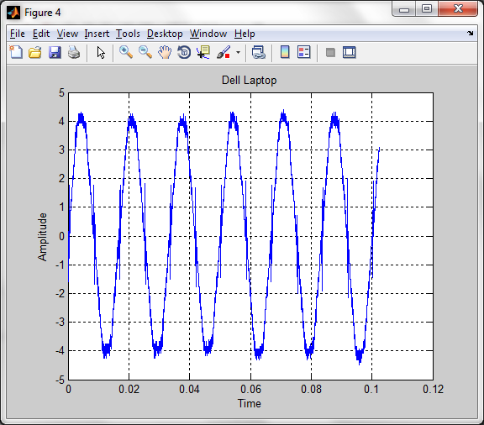
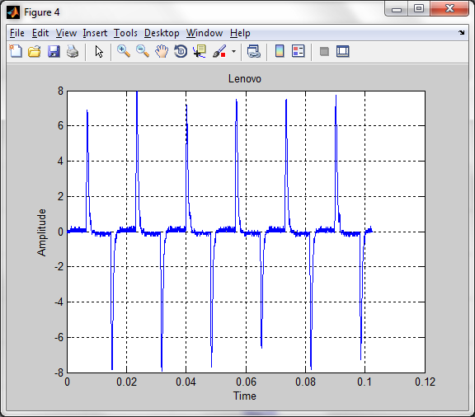
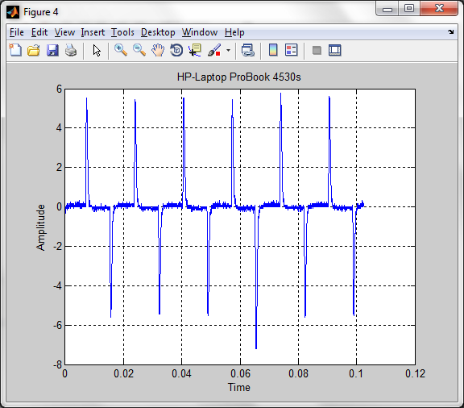
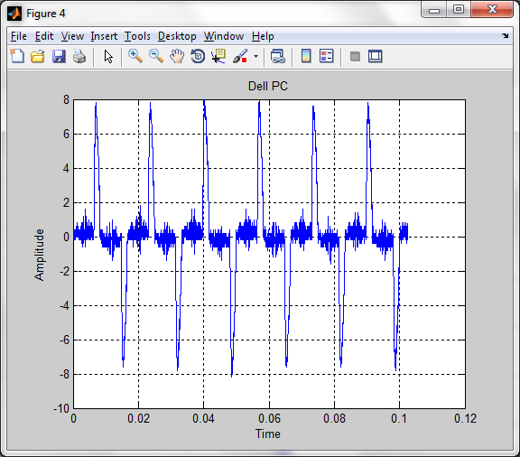
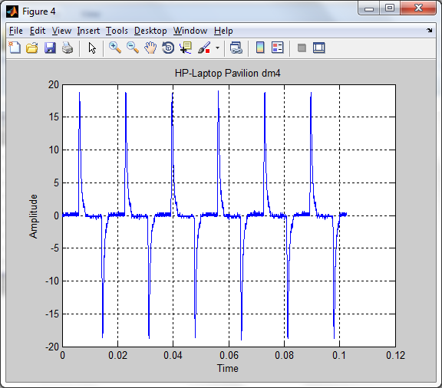
Dell Laptop
Lenovo
HP Probook 4530s
Dell PC
HP Pavilion dm4

Slide 4
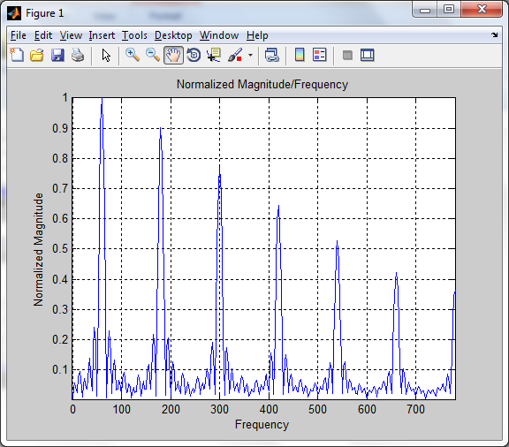
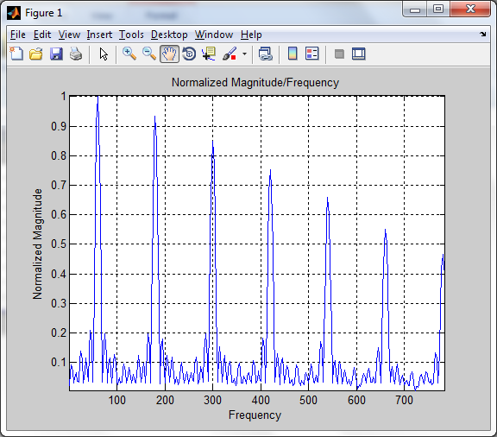
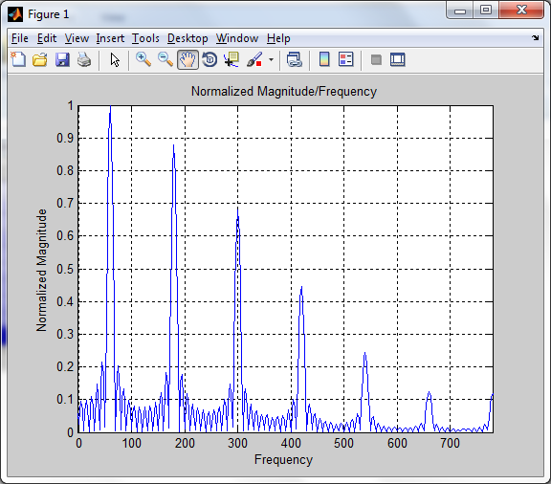
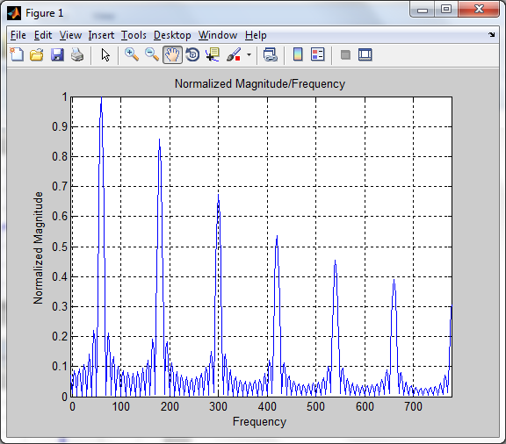
Harmonics of Different Computers
Lenovo
HP Probook 4530s
Dell PC
HP Pavilion dm4

Slide 5
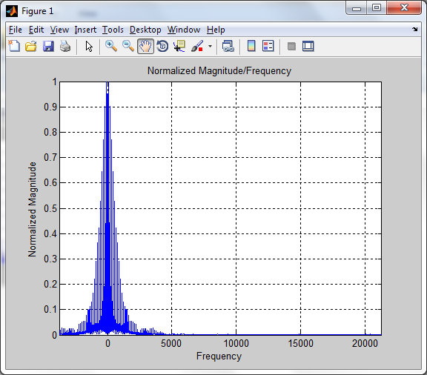
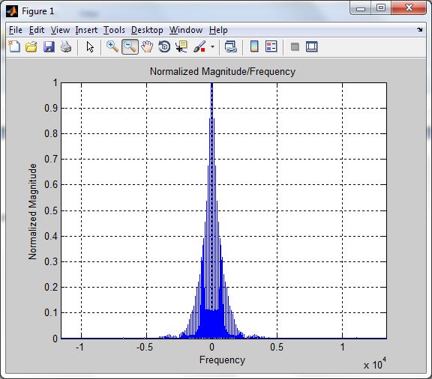
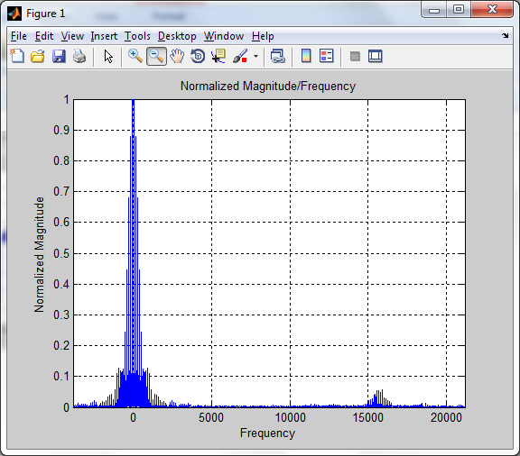
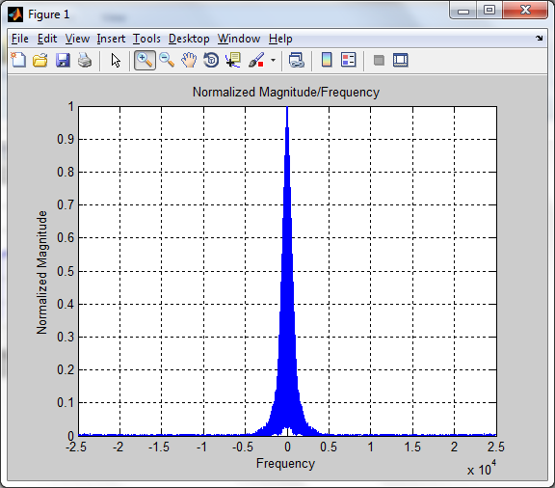
Resonant Harmonics
Lenovo
HP Probook 4530s
Dell PC
HP Pavilion dm4

Slide 6
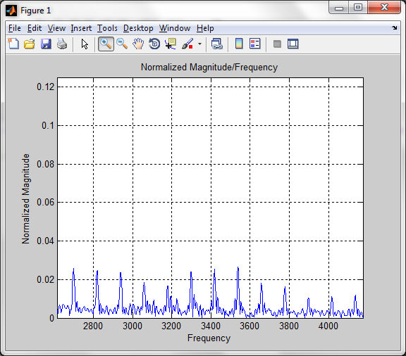
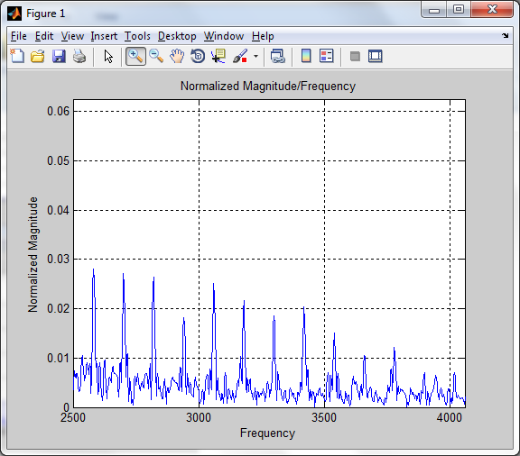
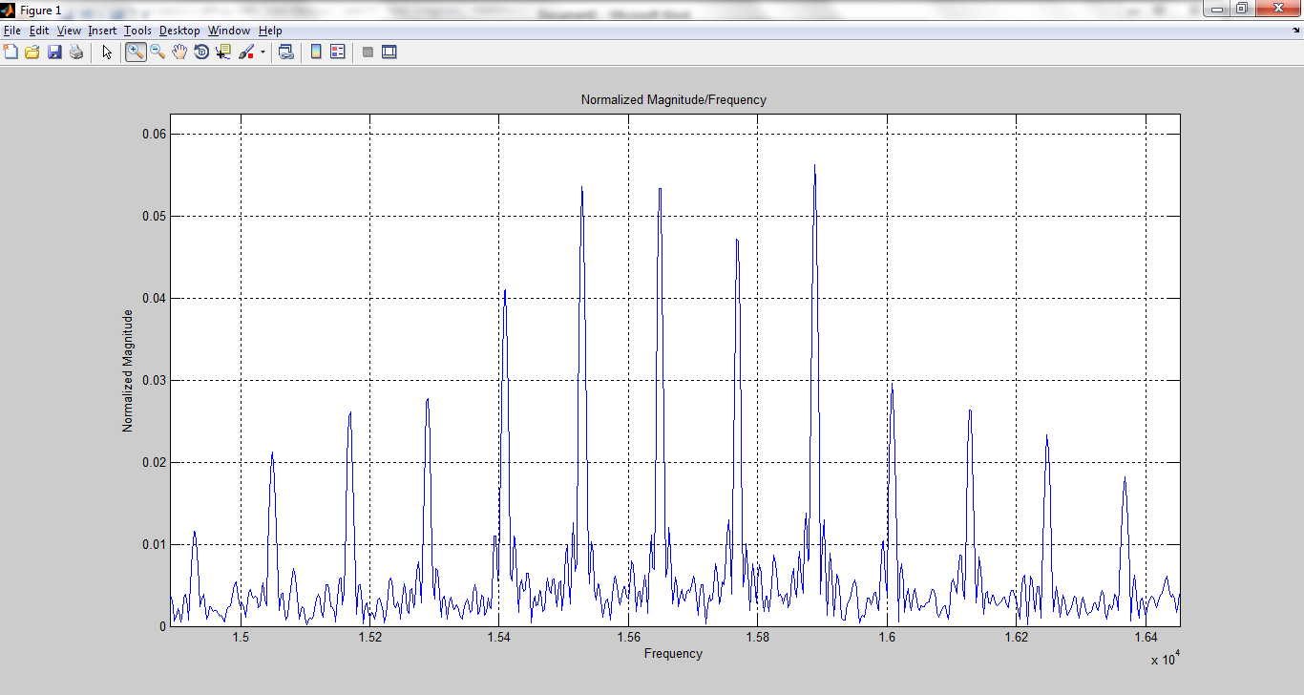
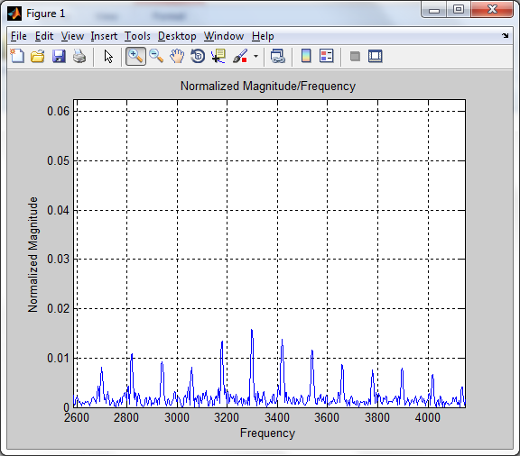
Resonant Harmonics
Lenovo
HP Probook 4530s
Dell PC
HP Pavilion dm4

